Slide 1
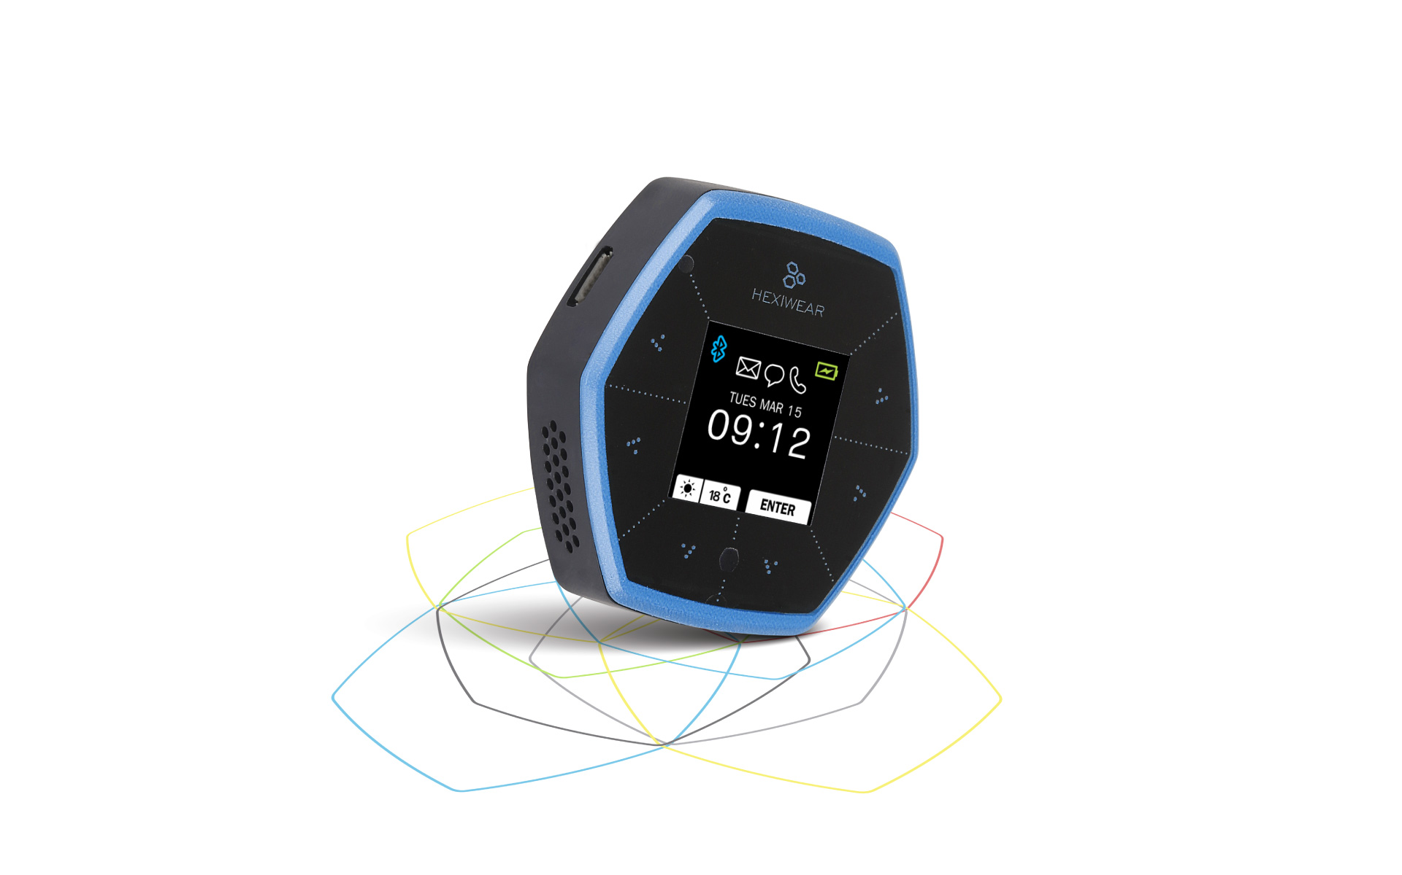
HexiMed
Initial Design Review
Sponsor: Dr. Kevin Kemp
Faculty Advisor: Dr. Semih Aslan

Slide 2
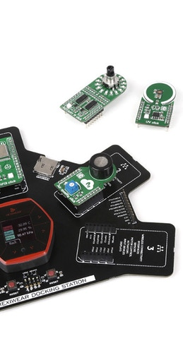
Why HexiMed?
Lack of medication adherence is estimated to cause 125,000 deaths per year
Costs between $100-$289 billion a year to tax payers
People typically take only half of prescribed doses
Notes:
Lack of medication adherence is estimated to cause 125,000 deaths
Costs between $100 billion and $289 billion a year to tax payers
People typically take only half of prescribed doses

Slide 3
Project Overview
HexiMed features:
Visual and Sound Alarm
Medication Pill Tracking
Medication History
A demo project that demonstrates the useful capabilities of the Hexiwear system.
Notes:
HexiMed features:
Sending a visual and sound alarm to alert user when it is time to take medication.
Attaching NFC Tags to prescription bottles.
Tracking each time a medication is taken and log the date/time onto an SD Card.
A demo project that demonstrates the useful capabilities of the Hexiwear system.

Slide 4
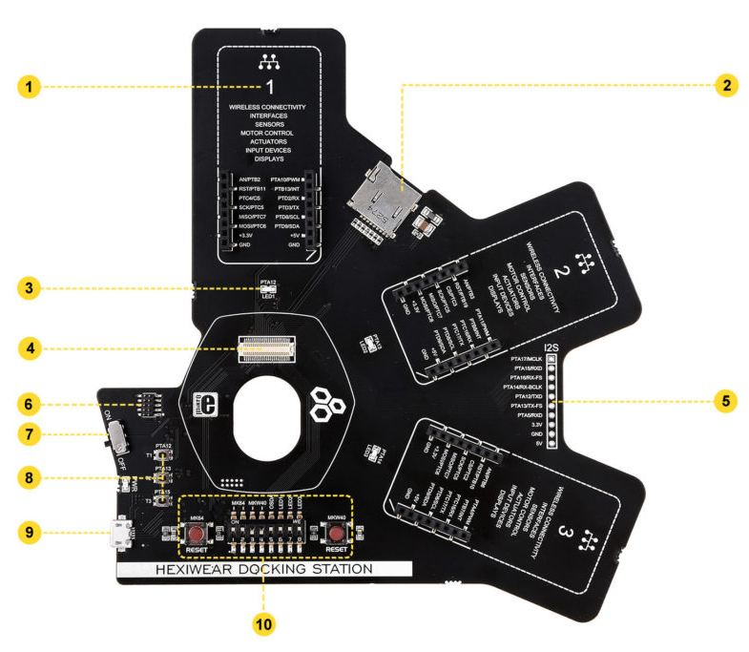
Hexiwear Docking Station
mikroBUS™ socket for click boards™ (one of three)
microSD slot (card not included)
LED (one of three)
Hexiwear connector that interfaces to Hexiwear's main MCU (K64x) and Wireless MCU (KW4x)
I2S interface
JTAG connector for external programmers
ON/OFF switch
Pushbuttons
Micro USB port
OpenSDA control interface

Slide 5
Top-Level Block Diagram
Pre-existing Components
Pre-existing Components
NFC Tags
NFC Tags
Designed by HexiMed Team
Designed by HexiMed Team
BUZZ 2 Click
NFC Click
Hexiwear Device Kinetis K64 MCU
Hexiwear Device Kinetis K64 MCU
HexiMed Code
HexiMed Code
Expansion Port
Expansion Port
SD Card
SD Card
External Hexiwear Docking Station
3x MikroBUS sockets
External Hexiwear Docking Station
3x MikroBUS sockets
Matrix RGB Click
Matrix RGB Click
Matrix RGB LED Panel
Matrix RGB LED Panel
HexiMed Interface
HexiMed Interface
Notes:
DELETE THIS SLIDE WHEN DONE!

Slide 6
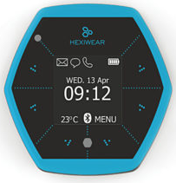
User Input Sequence
NFC Tag Number:
1
Alarm Time:
8:00AM
Days of Week:
M
# of Pills per Dose:
1

Slide 7
# of Pills in Bottle:
20

Slide 8
Logical Flowchart
User Input Sequence
User Input
System Logic
Alerts:
BUZZ 2 Click
LED Flash
NFC Tag #
Logged as “Missed Dose”with Date & Time to SD Card
NFC Tag Scanned?
No
Correct NFC Tag Scanned?
Logged as “Taken Dose” with Date & Time to SD Card
Yes
No
Inform User to Scan Correct NFC Tag

Slide 9
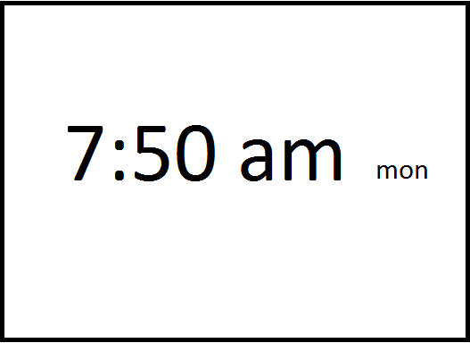
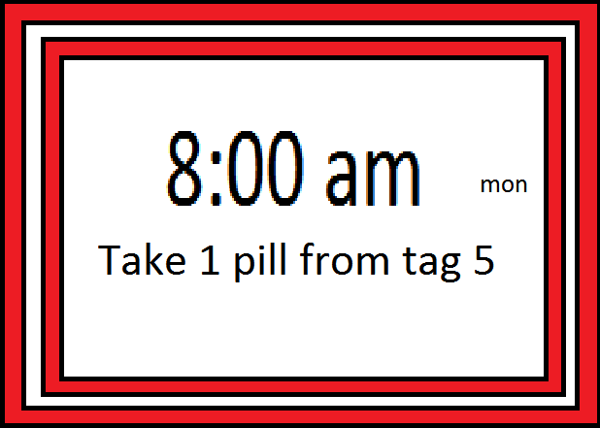

Home Screen Triggered Alarm

Slide 10
Project Goals
Project Goals:
User Input Sequence
Audio Alarm
Visual Alarm
Medication Pill Tracker
Medication History
Stretch Goals:
Common medication database
Design a mount for LED panel and docking station

Slide 11
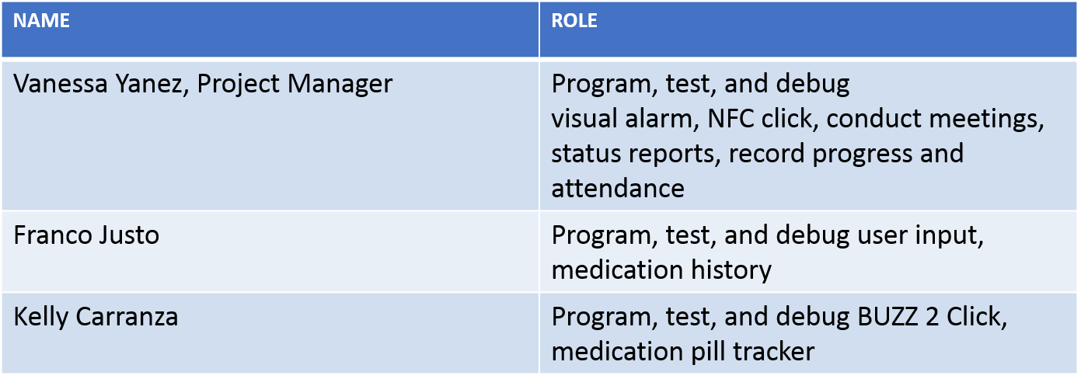
Roles & Responsibilities

Slide 12
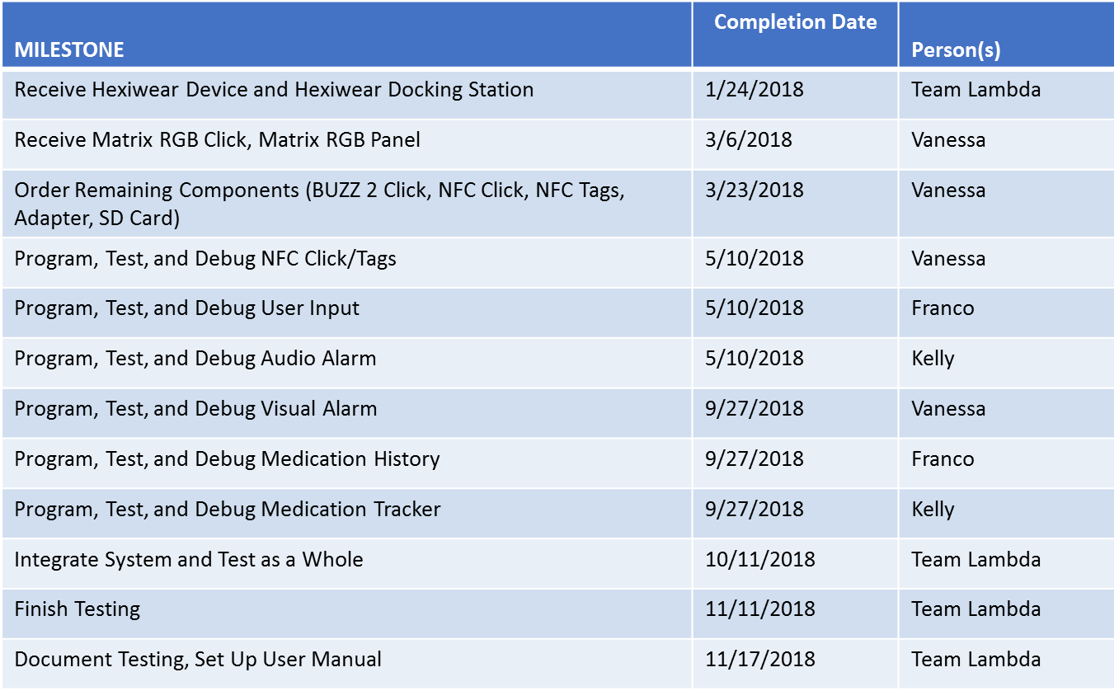
Project-Specific Milestones

Slide 13
Project Deliverables
Functioning HexiMed demo that meets project goals
Documentation with test results
User manual
Publish project description with HexiMed code to Hexiwear projects site
Notes:
List the MAJOR deliverables only. These are the deliverables for your PROJECT and NOT for the class! E.g., don’t list “Functional Spec” etc.

Slide 14
Functional Specification Review

Slide 15
2.3 Error Handling
Possible issues that may come up during testing:
NFC reader having problems reading tags
Freezing or delayed images
Alarm timing
Display and sound synchronization
SD card not detected
SD card having a reading/writing error or is full
Infinite loops
Notes:
Talk to this slide for no more than 1 minute! Remember: ALL designs must handle errors! You may have to think about what they might be!

Slide 16
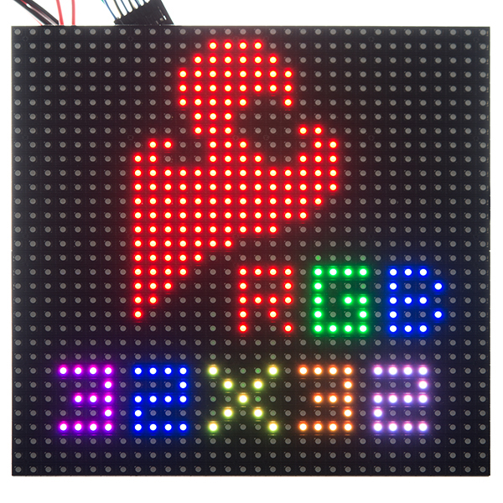
2.61 – User Interfaces
The user will have 5 primary interfaces within the HexiMed system:
1.1” OLED Hexiwear Screen
7.5x7.5” LED Panel
Audio Alarm
NFC Tags
Memory Interface
7.5”
7.5”
Notes:
The user will have 4 primary interfaces within the HexiMed system:
1.1” OLED Hexiwear Screen with capacitive buttons
A 7.5x7.5” LED Panel which will display the medication information the user needs to see as well as a visual flashing alarm.
A Buzz 2 Click necessary to emit an audible sound alarm.
Individual NFC tags that the user will scan to the NFC Click, which will then read if the correct medication is scanned.

Slide 17
2.62 – Software Interfaces
Arm Mbed OS will be used to program HexiMed.
HexiMed software will be implemented through a physical connection using the Hexiwear Docking Station.
Notes:
These are interfaces between one piece (or language) of software and another due to your design. If this section is not relevant to your project then delete this slide.

Slide 18
2.63 – Hardware Interfaces
HexiMed will consist of the following hardware components: ● Hexiwear ● Hexiwear Docking Station ● BUZZ 2 Click ● NFC Click ● NFC Tags ● Matrix RGB Click ● Matrix RGB Panel
Notes:
These are interfaces between two pieces of hardware, e.g., you connected a sensor to a pi. If this section is not relevant to your project then delete this slide.

Slide 19
2.7 Boundary Conditions & Constraints
Boundary Condition:
7.5X7.5 inch LED panel
5 medications
NFC tags attached
Constraint:
$500 Budget
Use of Hexiwear
USB powered docking station with 3 expansion slots
Notes:
List the boundary conditions and make sure your Sponsor agrees that they are indeed boundary conditions. Talk to this slide for no more than 1 minute!

Slide 20
2.8 Performance
Software Performance Parameters
Function | Description | How Tested
Hexiwear OLED Interface | User inputs information (Tag #, Number of Pills in Bottle, Time of Day to be taken, # of Pills per Dose) on Hexiwear device. | Test by inputting information of 50 usage instances.
Stored Data | A SD card inserted into the docking station will store medication information. | Test by checking if data is stored each time after 50 usages.
User Interface | Display on RGB LED Matrix Panel will load in 5 seconds or less. | Use a timer to measure load time of 50 usage instances
Visual Alarm | The LED display will create a visual flashing medication alarm. | Test by implementing alarm and collecting data of 50 usage instances.

Slide 21
2.8 Performance
Software Performance Parameters
Function | Description | How Tested
Log Data | The NFC sensor will read medication tags scanned within a 2cm-3cm and log medication name and time to SD card. | Test by scanning tags and collecting data of 50 usage instances.
Sound Alarm | The BUZZ 2 Click will create audible medication alarms, signal frequency determines the sound pitch and duty cycle determines sound volume. | Test by implementing alarm code and collecting data from 50 usage instances of 100 dB at 4kHz.
Memory Usage | Hexiwear’s Kinetis K64 MCU has a limit of 1MB of flash memory. | Upload code into Hexiwear, observe functionality and performance of system after 50 usages.

Slide 22
2.10 Service, Support & Maintenance
A user manual will be provided to help with any software maintenance & support issues.
User Manual:
Starting HexiMed
Creating Alarms
Scanning Medication NFC Tags
Accessing Logged Data on SD Card
Troubleshooting
Notes:
What platforms does your system run on? If this section is not relevant to your project then delete this slide. If relevant, talk to this slide for no more than 1 minute!

Slide 23
2.11 Expandability or Customization
Expandability:
Adding LED panels to increase screen size
Increasing the amount of prescriptions the system can hold
Customization:
Option to input what time the alarms will be triggered
Notes:
What platforms does your system run on? If this section is not relevant to your project then delete this slide. If relevant, talk to this slide for no more than 1 minute!

Slide 24
Challenges & Concerns
Inputting user information on the 1.1” OLED screen of Hexiwear device
SD card functions
LED Panel or font size too small
NFC tag attachment
Notes:
Word this carefully – OK to ask questions and seek resolution during the IDR. CLASS DELIVERABLES and/or team meetings ARE *NOT* CHALLENGES!!!

Slide 25
Project Progress
Research Completed for:
Hexiwear
Hexiwear docking station
Click boards
Code integration using Mbed
Parts obtained:
Hexiwear device and docking station
Matrix RGB Click
Matrix RGB Panel
Notes:
Go through this at a good pace. You could spend 30 minutes on this alone – don’t. Just give an overview.

Slide 26
Future Tasks
Tasks Planned for the Completion of the project:
Program functions for User Input
Medication Tracking
Medication History
Buzz 2 Click
NFC Click
Matrix RGB Click
Individual function testing
Assemble Docking Station with Hexiwear and all click boards
Perform tests of the system as a whole
Document successes and failures within testing
Notes:
High level tasks! DO NOT enter items like, “order 100 ohm resistors.”

Slide 27
HexiMed Overview
Notes:
High level tasks! DO NOT enter items like, “order 100 ohm resistors.”

Slide 28
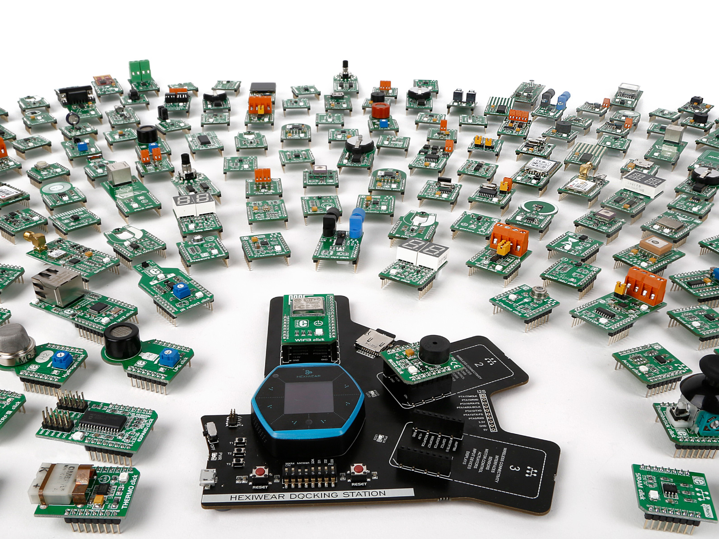
Questions?

